Slide 1
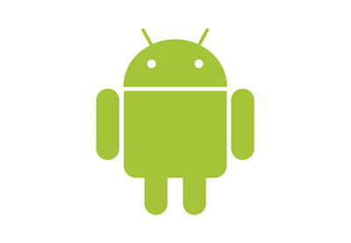

בס"ד
Remote Control Joystick-
Android App
Advanced Programming 2 89211
Orna Tapeta ,Uriel Schwell

Slide 2


Who are we?
MVVM Architecture
Our Application
Links
UML

Slide 3
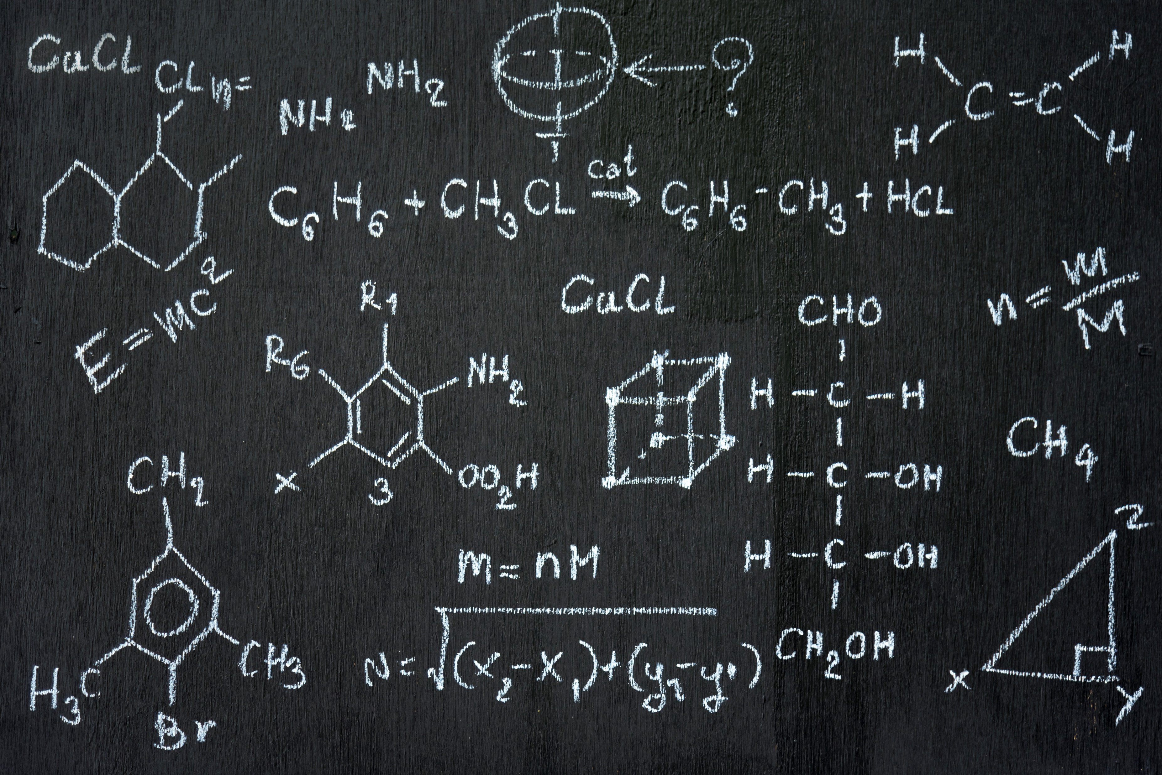

We are two second (2.5) year students in Bar Ilan University.
As a semi-final part of the course
“Advanced Programming 2” we were tasked to create an Android cell phone application that was capable of remotely controlling the “FlightGear” application via a remote Joystick

Slide 4
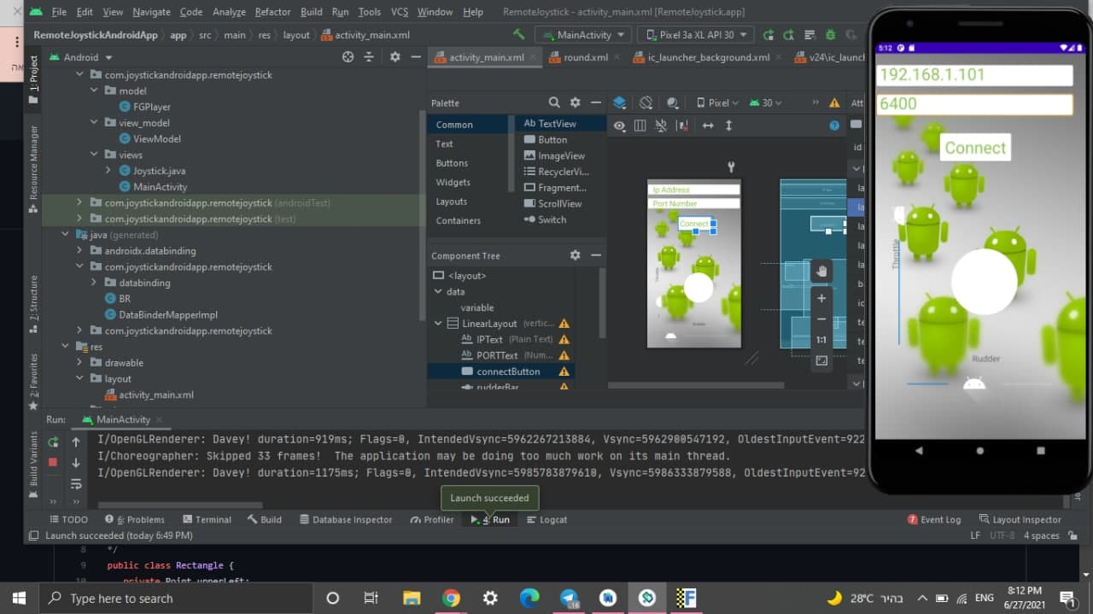

Our Application
Designed using MVVM
Permits the Control of our simulated flight with the help of a few intuitive sliders and a virtual joystick.

Slide 5
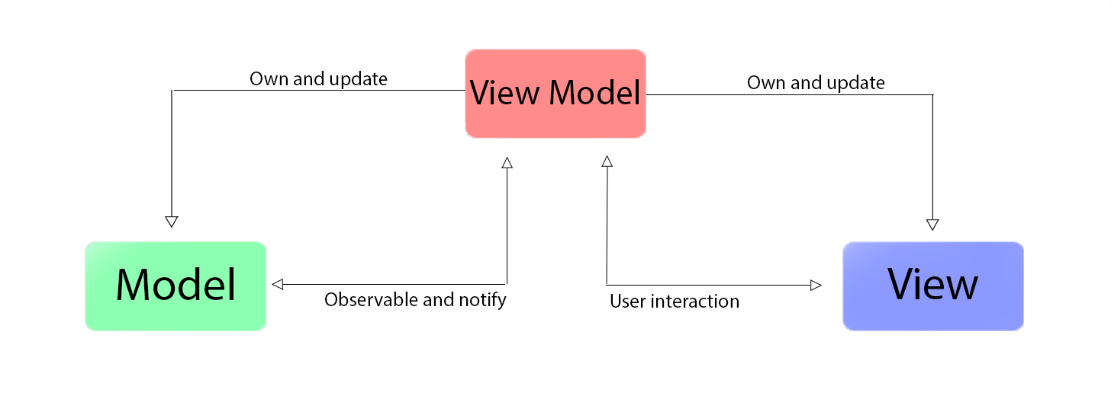
What is MVVM?

Slide 6

What is MVVM?
View:
Controls what we the User can see and interact with
Model:
Controls the actual Data and the business logic.
View Model:
Connects between the two sides. Keeps them functioning in separate threads/states

Slide 7


בס"ד
UML - diagram
ViewModel
setElevator
setRudder
setThrottle
setAileron
Update View
View
MainActivity
throtBarListener
rudBarListener
connectButtonListener
onClick(func)
Model
FlightGear
sendElevatorVal
sendAileronVal
sendRudderVal
sendThrottleVal
openSocket (server-client)
Joystick
JoystickListener(interface)
onTouchEvent
onDraw

Slide 8
Links
Github
Where you can see the code for the application itself
https://github.com/uschwell/Milestone3/tree/master
Demo
Linked below will be a demonstration of our application in use

Slide 9
בס"ד
DEMO

